Slide 1


PATH Training
Session One

Slide 2
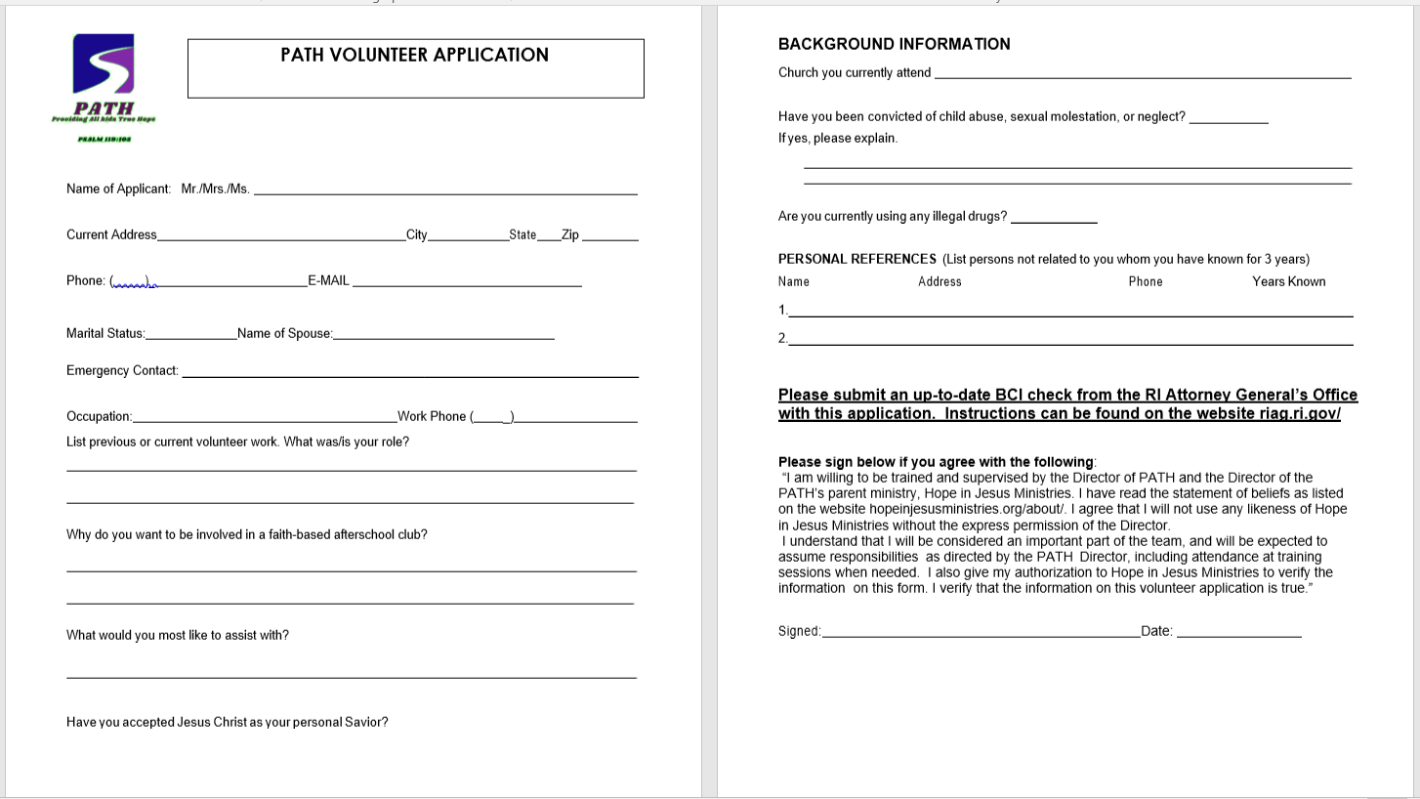

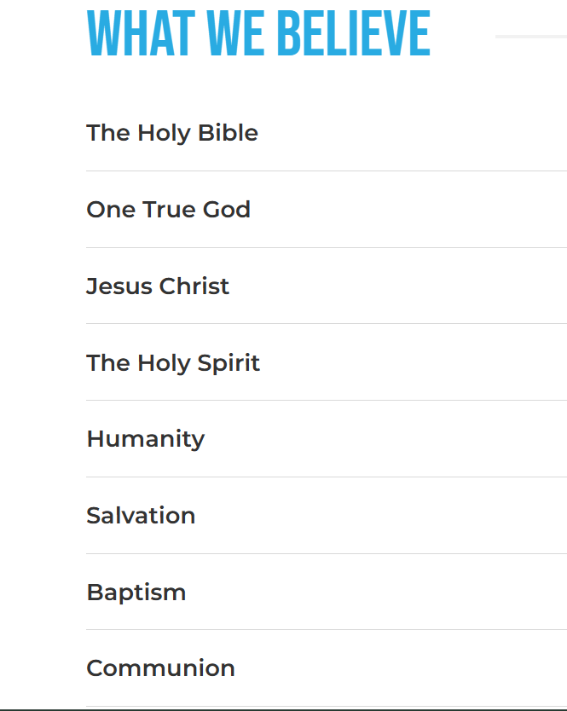
Application
HopeinJesusMinistries.org

Slide 3
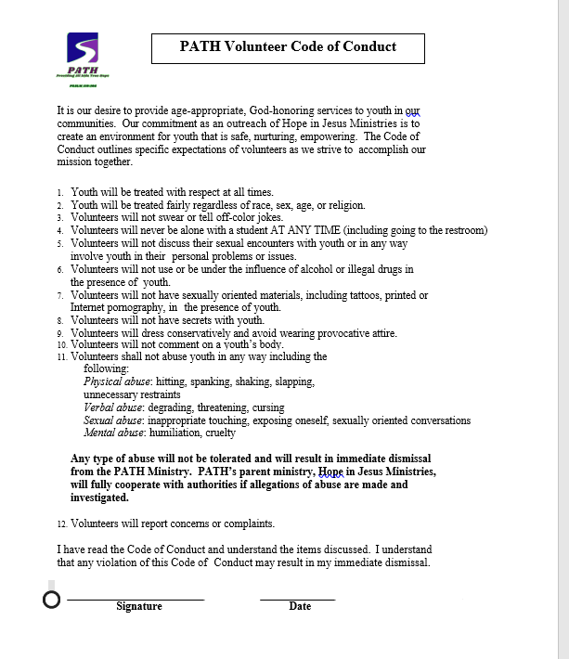

Code of COnduct

Slide 4

The PATH is intended to begin in elementary,
continue through middle and high school,
transition into collegiate,
with the culmination of a Hope Center for leadership and community service.
Our aim is to put young people
on the PATH
of hope, confidence,
and perseverance.

Slide 5
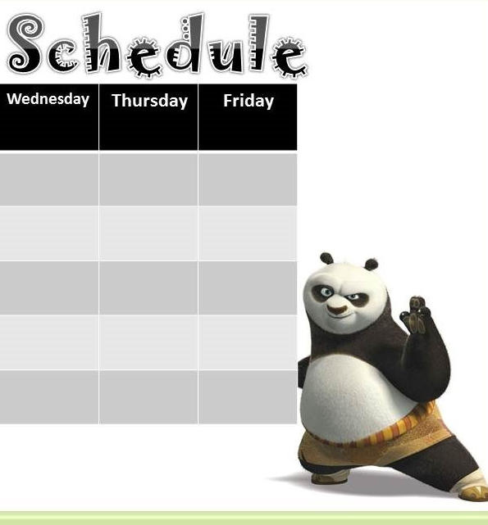
GROUP MANAGEMENT
ESTABLISH A STRUCTURE THAT WILL BE REPEATED FOR EVERY CLUB MEETING.
The provided curriculum
will help with the structure
as the lessons
are separated
into types of activities.

Slide 6

Give children advance warning when the routine will be different
Set clear limits and define what behavior is expected in each setting. It may help to display a few short basic expectations and for visual learners and to be able to refer to the list when needed.
Announce upcoming transitions, such as a 2 -minute warning before changing activities or settings.
Provide as much information as you can about new experiences in advance.
For multiple-step projects, provide visuals/examples each step of the way to illustrate the goal
Use visual timers/stopwatches to help monitor time left on tasks – this is helpful for those who get frustrated by not finishing.

Slide 7

GROUP activities
Assign jobs for all students. This contributes to a feeling of community and gives them a chance to be responsible and cooperative
Use auditory signals to get attention (bell), clap a pattern, or use a clear verbal signal such as “1,2,3, eyes on me”
To increase participation, incorporate opportunities to actively respond, such as “Turn to your partner and say….”
Always provide lots of positive reinforcement/praise when you see good behavior and participation

Slide 8
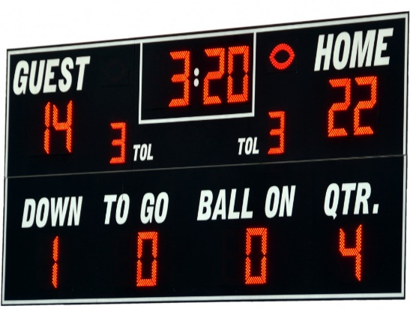





If group behavior becomes CHALLENGING,
Consider having a behavior monitoring SYSTEM
(Green/yellow/red, thumbs up/down, teams)
To give feedback on how they are doing.

Slide 9

Communication
Use brief, clear statements with one step at a time.
Be sure to add short moments for feedback during longer lessons to keep kids actively engaged whenever.
Try to use more positive language -more Do’s than Don’ts! For example, say: “Sit down over here” instead of “Don’t go over there”

Slide 10

Give directions instead of a choice when there really isn’t a choice. Say “Please put that down” instead of “Can you stop doing that?”
Be consistent and don’t say things
you can’t follow through on

Slide 11


Use lots of praise, the more specific the better,
before correcting or giving a consequence.
Kids make mistakes and bad choices. Pick the right battles.
Choose your battles.
Rather than getting upset about every little problem, address the behaviors that are most harmful

Slide 12

Be on the lookout
Anticipate problem behaviors and intervene before they get out of control
Watch for patterns in problem behavior: time of day, type of task, noise level, number of people around, etc.
Discuss ongoing problematic behavior with a parent/guardian to find out if there are patterns or issues of which you are unaware

Slide 13

You got this!
And He said to them, “Go into all the world and preach the gospel to every creature. Mark 16:15
Nor do they light a lamp and put it under a basket, but on a lampstand, and it gives light to all who are in the house. Let your light so shine before men, that they may see your good works and glorify your Father in heaven. Matthew 5:15-16
And let us not grow weary of doing good, for in due season we will reap, if we do not give up. So then, as we have opportunity, let us do good to everyone, and especially to those who are of the household of faith. Galatians 6:9-10

